Slide 2
Model 0
mean_prob ~ exp(logalpha) * eta,
eta ~ 1 + expected_phoneme + age_months + (1 | speaker)
logalpha ~ 1 + expected_phoneme
phi ~ 1 + expected_phoneme + age_months
family = Beta(link = "logit")
Model 1:
phi ~ 1 + expected_phoneme
Model 2:
phi ~ 1 + age_months

Slide 3
Model 5
mean_prob ~ exp(logalpha) * eta
eta ~ 1 + expected_phoneme + ns(age_months,2) + (1 | speaker)
logalpha ~ 1 + expected_phoneme
phi ~ 1 + expected_phoneme + age_months
Model 4:
eta ~ 1 + expected_phoneme + ns(age_months,3) + (1 | speaker)
Model 6:
eta ~ 1 + expected_phoneme + ns(age_months,4) + (1 | speaker)

Slide 4
Model 3
mean_prob ~ inv_logit(asymptote)/ (1 + exp(-exp(logalpha) * eta)), asymptote ~ (1 + expected_phoneme)
eta ~ 1 + expected_phoneme + age_months + (1 | speaker), logalpha ~ 1 + expected_phoneme
phi ~ 1 + expected_phoneme + age_months
Model 7:
phi ~ 1 + expected_phoneme
Model 8:
phi ~ 1 + age_months

Slide 5
Model 10
mean_prob ~ inv_logit(asymptote)/ (1+ exp(-exp(logalpha) * eta))
asymptote ~ (1 + expected_phoneme)
eta ~ 1 + expected_phoneme + ns(age_months,2) + (1 | speaker)
logalpha ~ 1 + expected_phoneme
phi ~ 1 + expected_phoneme + age_months,
Model 9:
eta ~ 1 + expected_phoneme + ns(age_months,3) + (1 | speaker)
Model 11:
eta ~ 1 + expected_phoneme + ns(age_months,4) + (1 | speaker)

Slide 6
Elpd_loo
phoneme_group | model0 | model1 | model2 | model5 | model4 | model6 | model3 | model7 | model9
Vowels_Level1_Level2 | 2372.401 | 2353.463 | 2156.426 | 2390.861 | 2390.813 | 2389.415 | 2403.365 | 2390.616
Vowels_Level4_Level5 | 2404.282 | 2400.335 | 2109.844 | 2408.223 | 2408.925 | 2408.521 | 2403.969 | 2405.102
Vowels_Level3 | 2137.326 | 2133.97 | 1847.267 | 2143.506 | 2143.099 | 2142.881 | 2137.805 | 2133.954
Consonants_Level3 | 1588.812 | 1585.823 | 1454.607 | 1593.913 | 1593.435 | 1592.723 | 1587.373 | 1585.398
Consonants_Level4 | 2206.72 | 2199.826 | 1091.63 | 2209.201 | 2209.313 | 2210.509 | 2205.397 | 2199.312
Consonants_Level5 | 1997.365 | 1988.928 | 1705.229 | 2002.034 | 2003.448 | 2003.823 | 1998.001 | 1989.43
Consonants_Level6 | 3392.083 | 3394.443 | 3015.966 | 3395.633 | 3395.839 | 3394.411 | 3419.95 | 3419.083

Slide 7
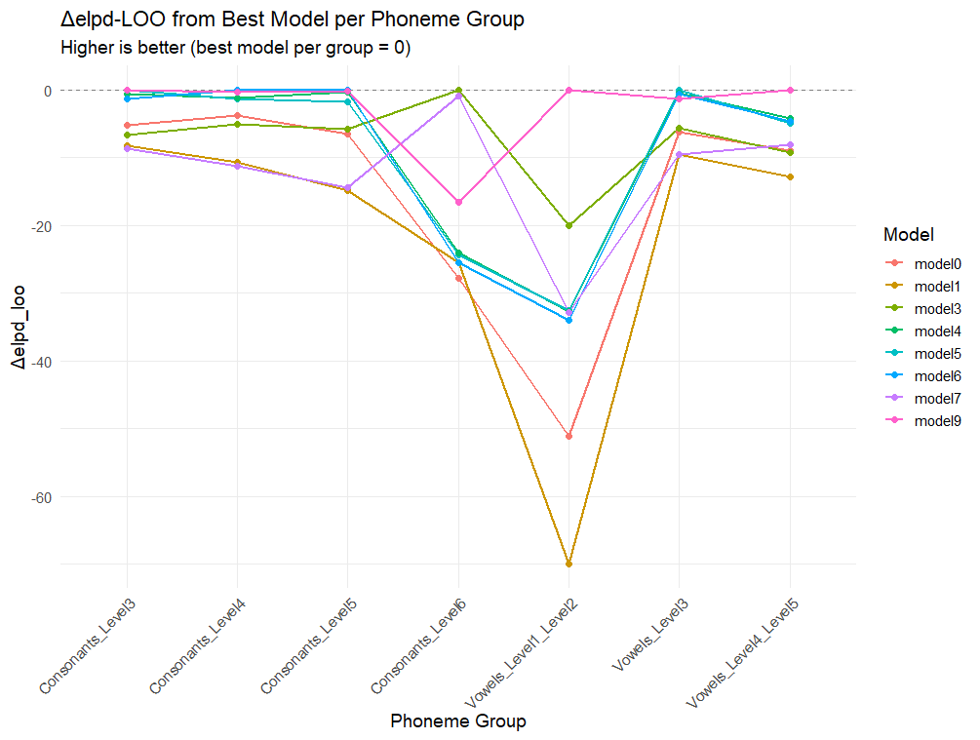
Elpd_loo

Slide 8
Elpd_WAIC
phoneme_group_str | model0 | model1 | model2 | model5 | model4 | model6 | model3 | model7 | model9
Vowels_Level1_Level2 | 2393.092 | 2374.487 | 2182.939 | 2410.38 | 2410.227 | 2409.42 | 2419.991 | 2402.077
Vowels_Level4_Level5 | 2415.948 | 2411.21 | 2164.973 | 2418.887 | 2419.572 | 2419.195 | 2414.91 | 2417.448
Vowels_Level3 | 2147.667 | 2144.206 | 1872.456 | 2152.775 | 2152.421 | 2152.359 | 2147.684 | 2143.894
Consonants_Level3 | 1600.888 | 1597.5 | 1463.83 | 1605.669 | 1605.023 | 1604.047 | 1599.493 | 1597.262
Consonants_Level4 | 2229.397 | 2221.439 | 1130.135 | 2231.873 | 2231.876 | 2231.778 | 2227.83 | 2222.062
Consonants_Level5 | 2020.428 | 2012.202 | 1736.183 | 2025.571 | 2026.5 | 2026.69 | 2021.515 | 2012.907
Consonants_Level6 | 3404.868 | 3406.603 | 3022.617 | 3407.665 | 3407.337 | 3406.832 | 3428.673 | 3428.014

Slide 9
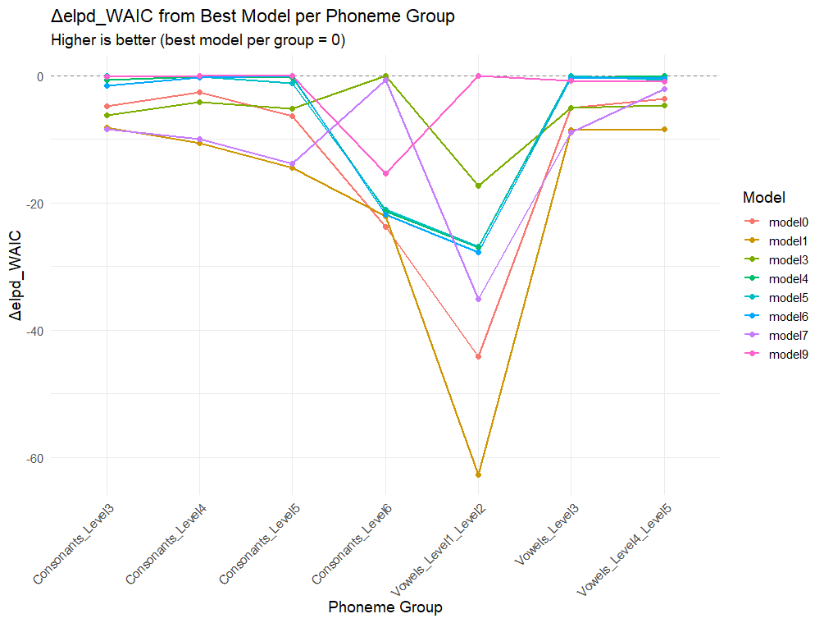
Elpd_WAIC

Slide 10
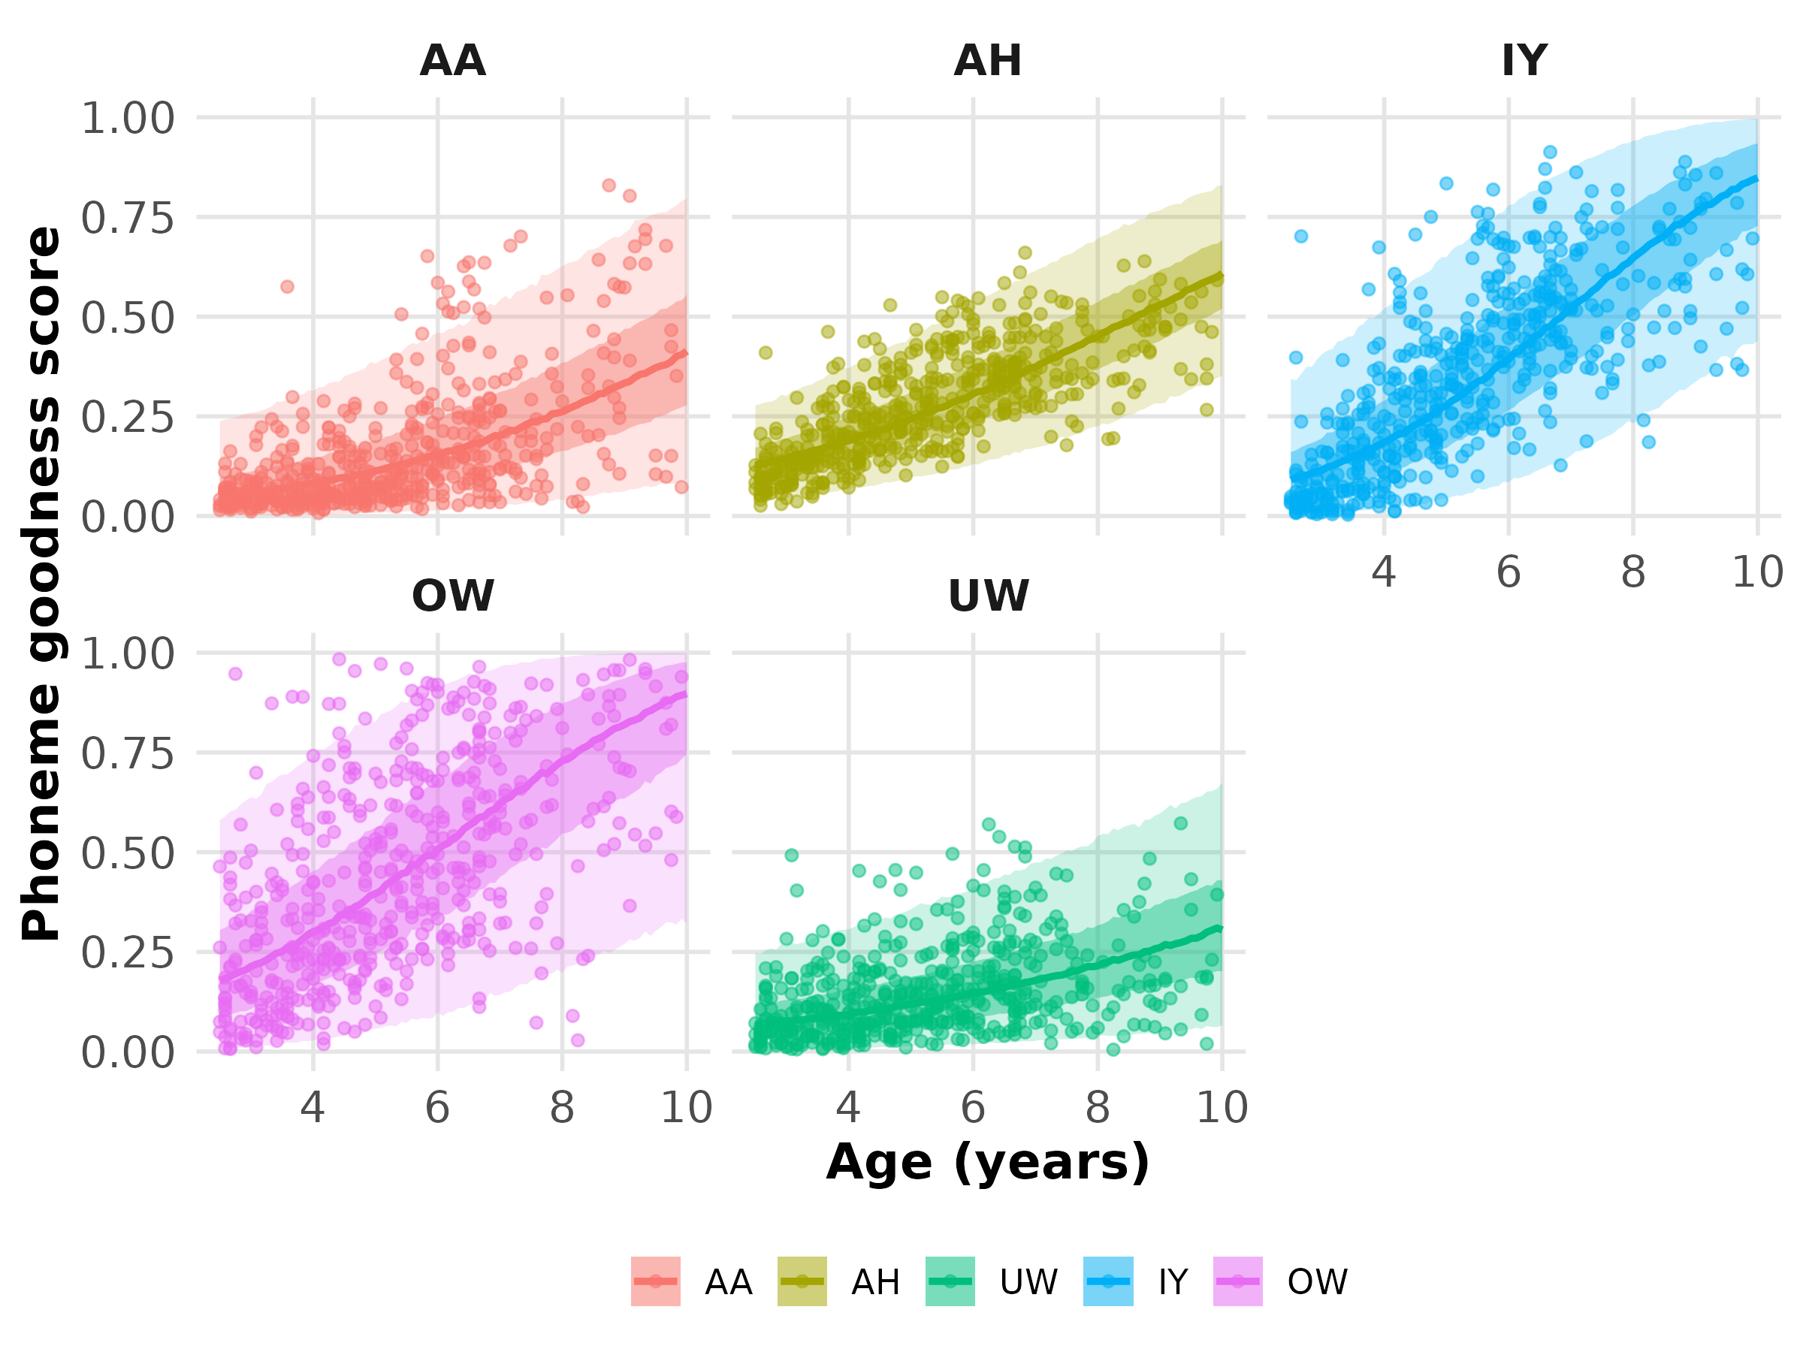
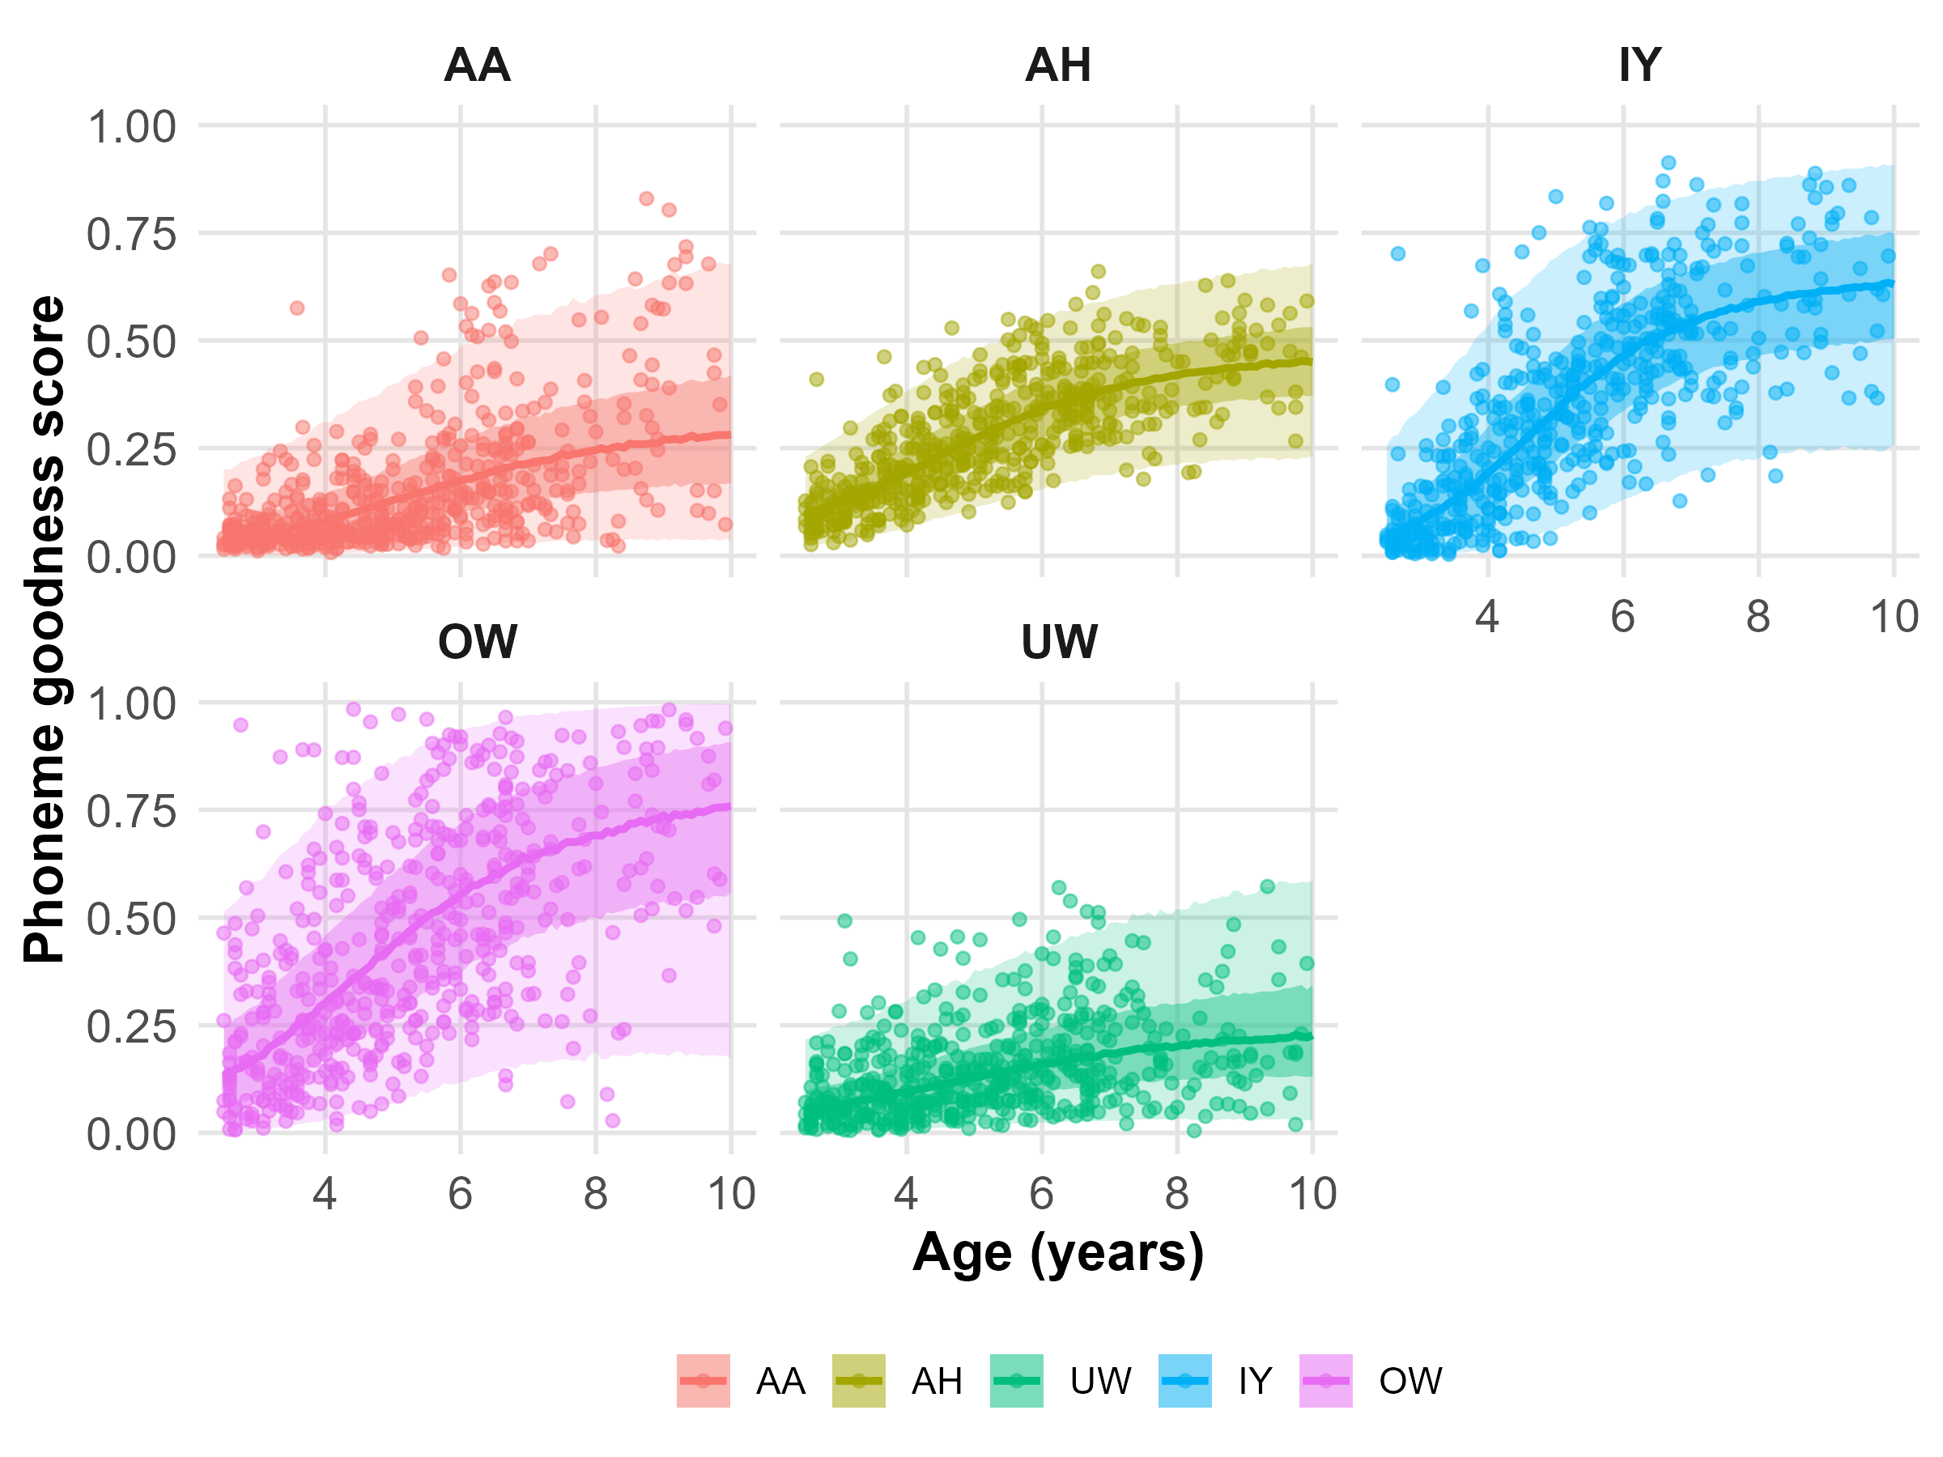
Vowels Level 1 and 2
Model 0
Model 9

Slide 11
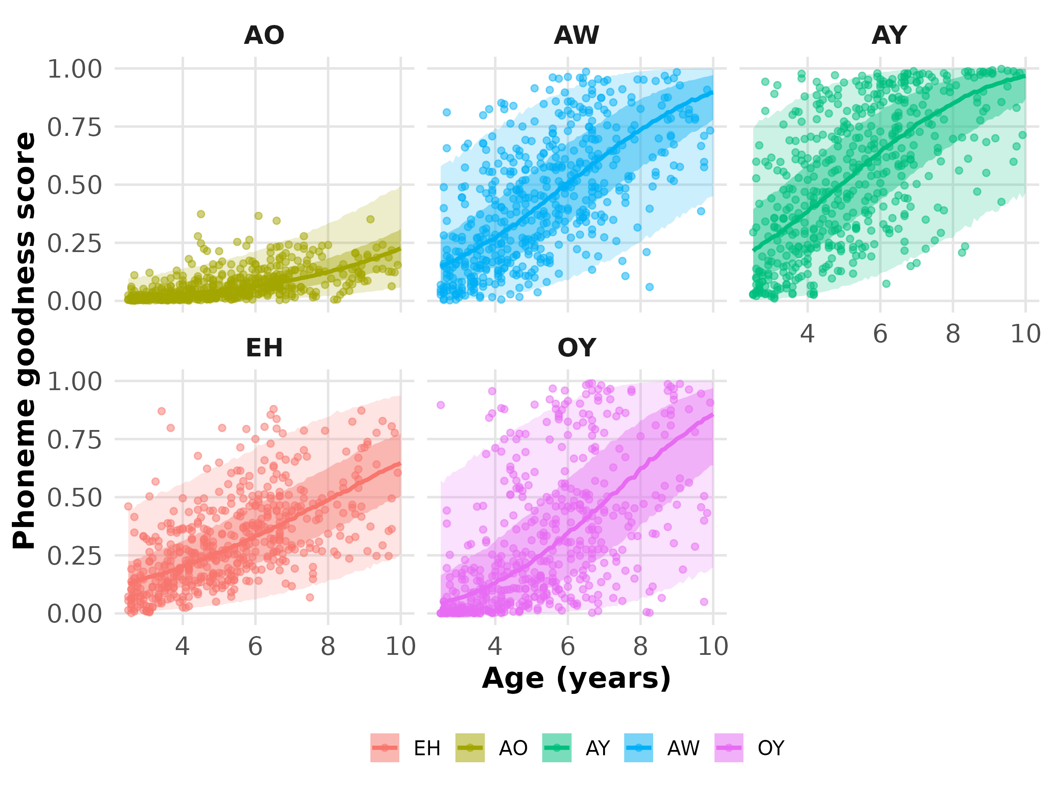
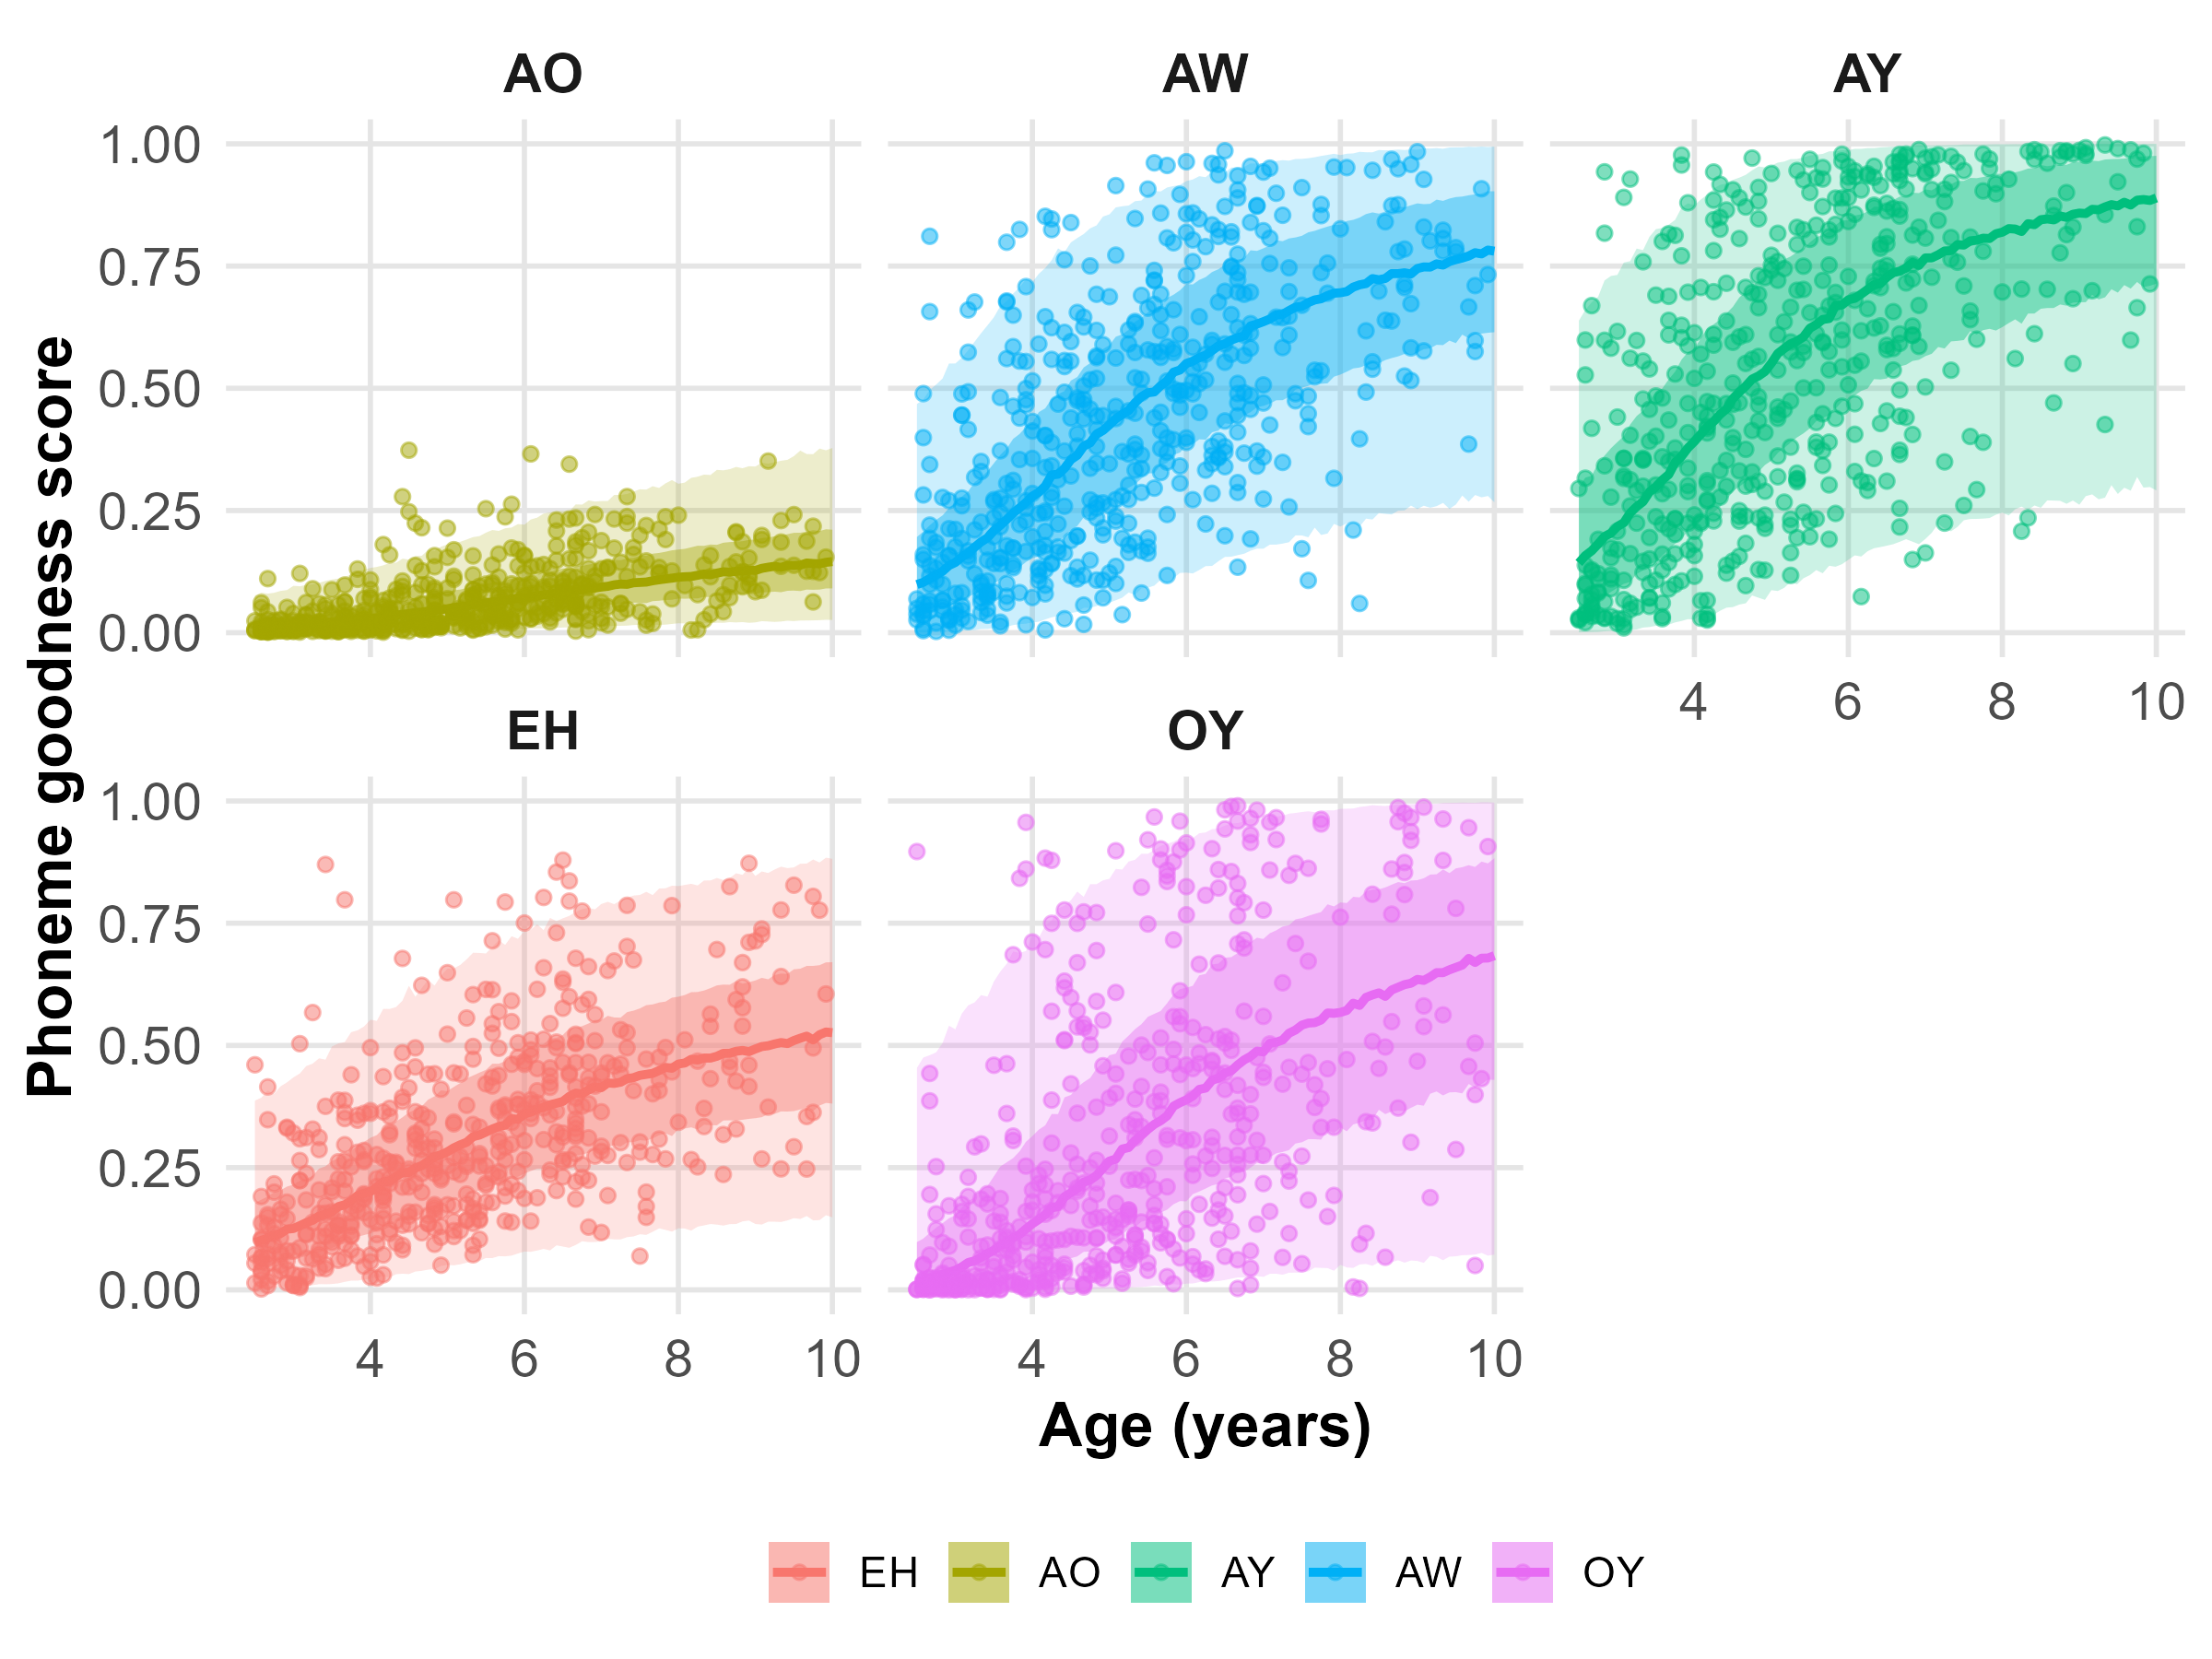
Vowels Level 3
Model 0
Model 9

Slide 12
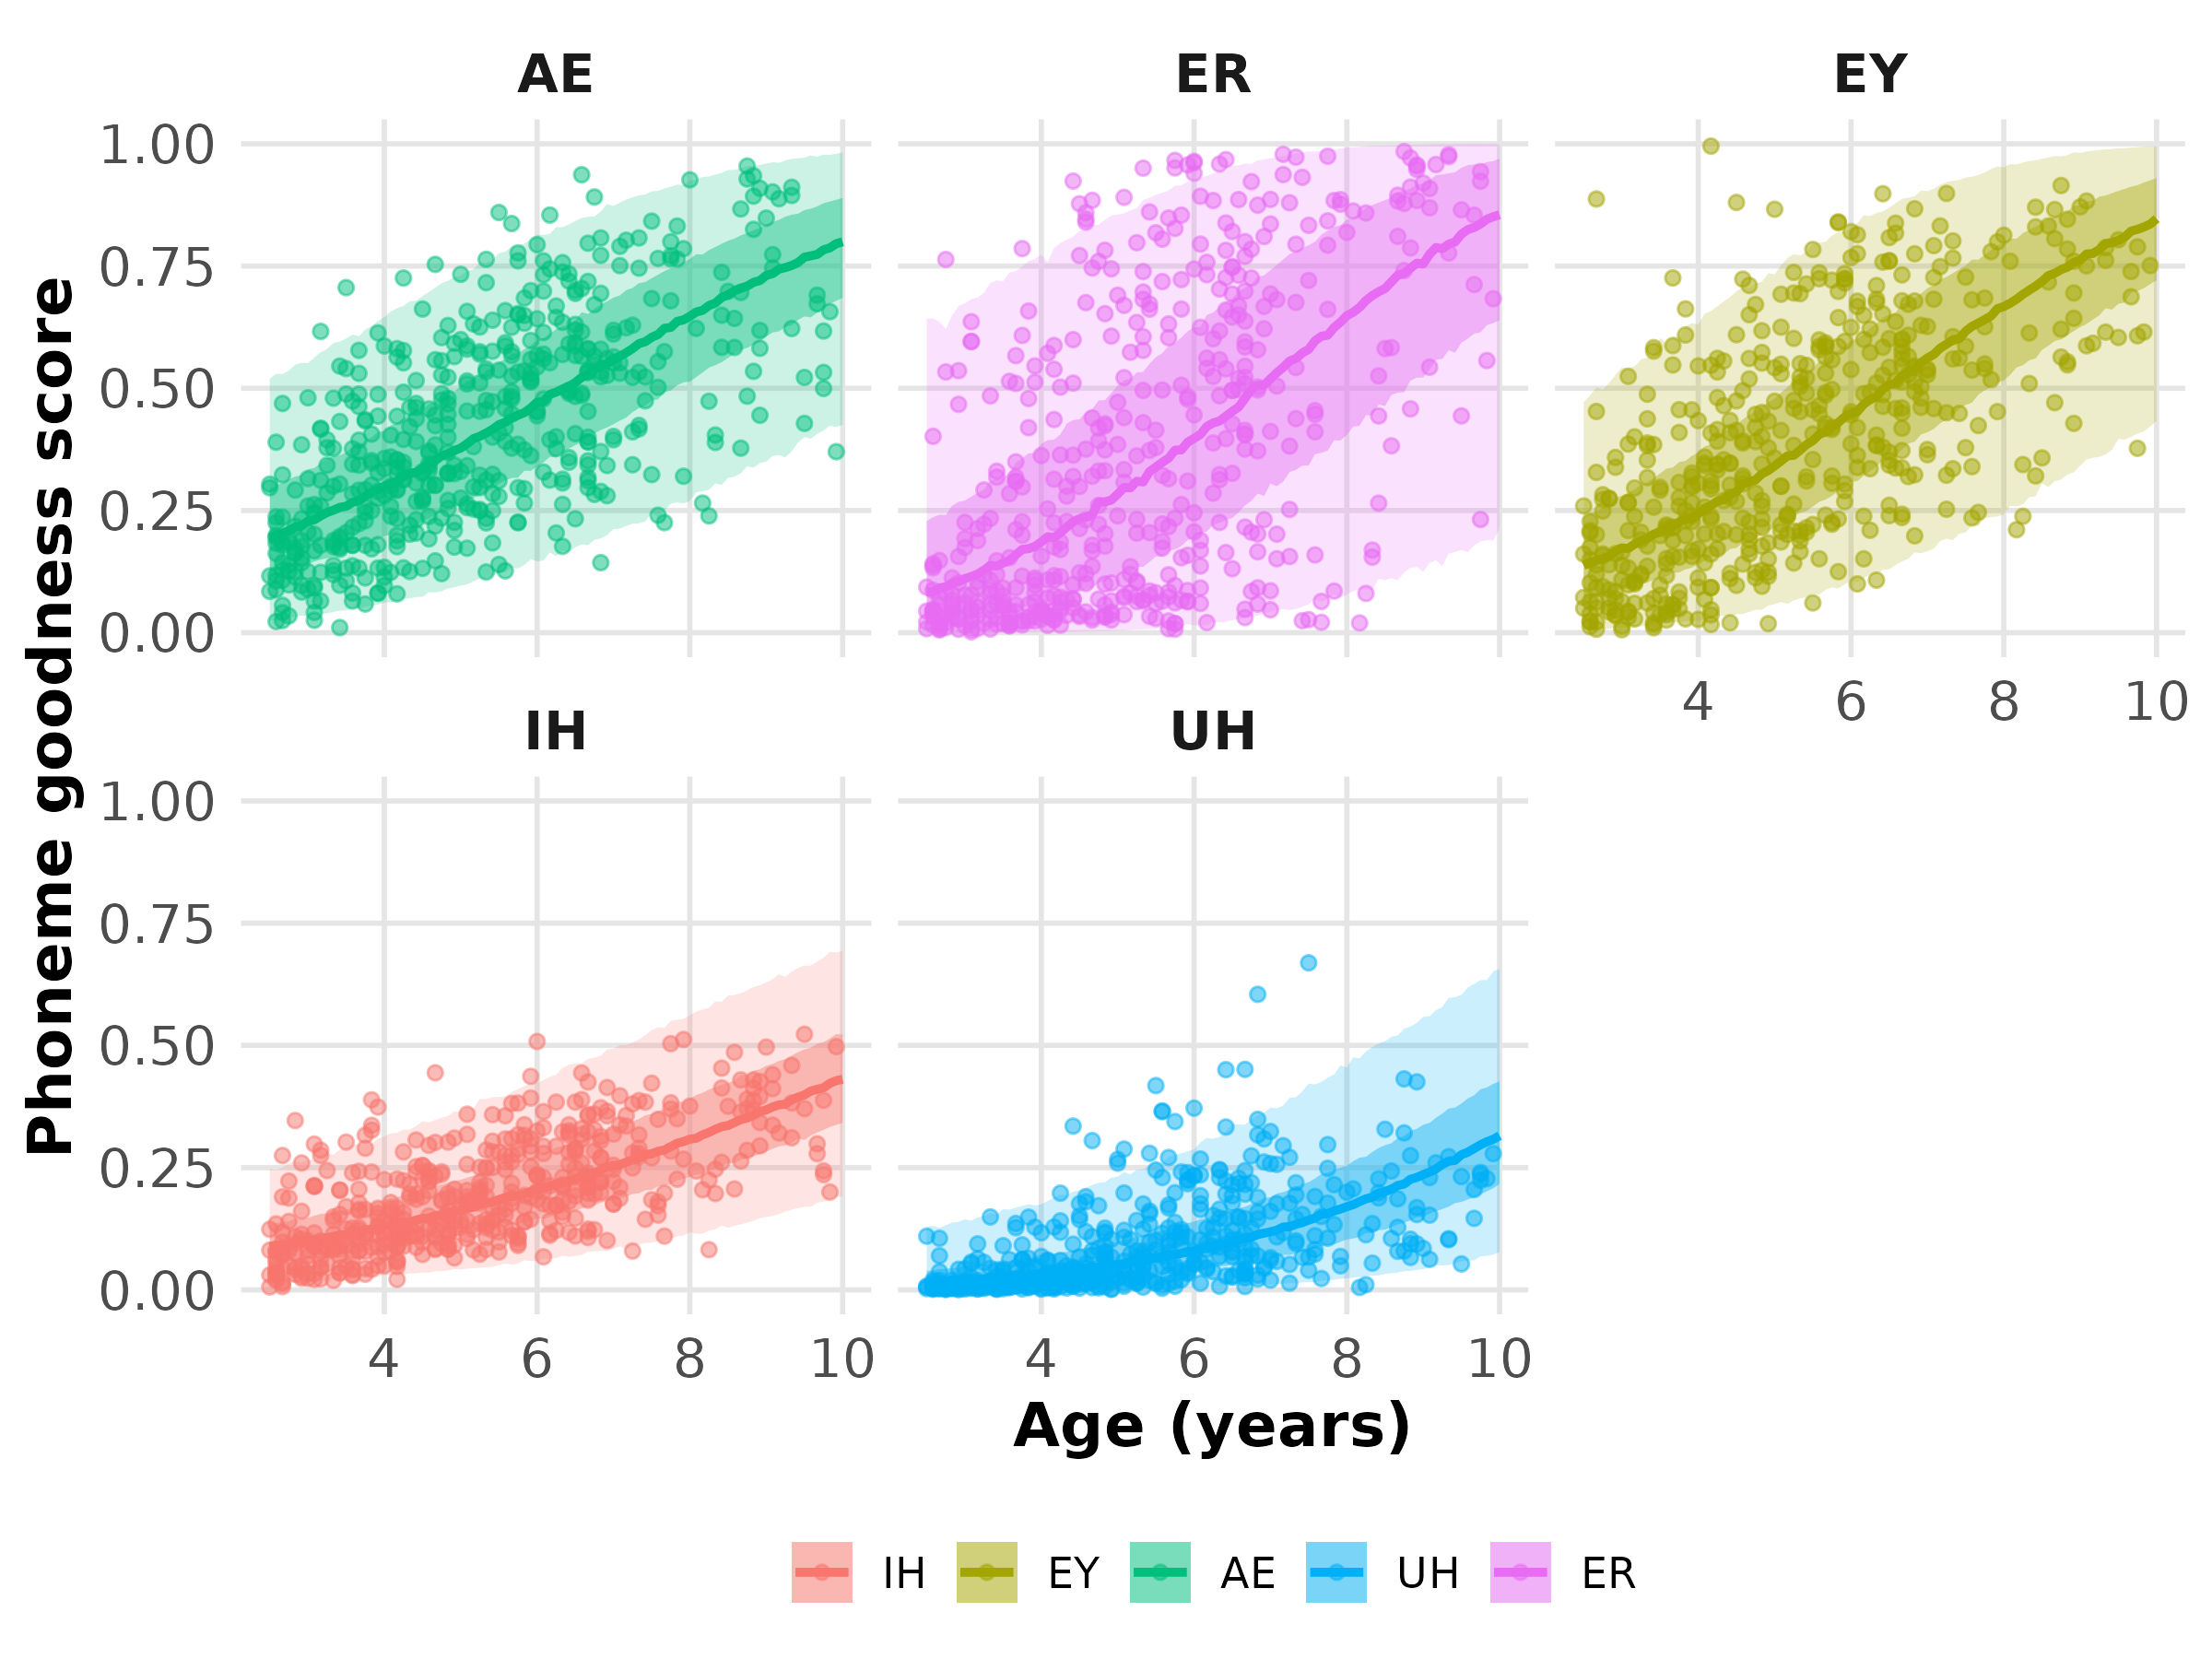
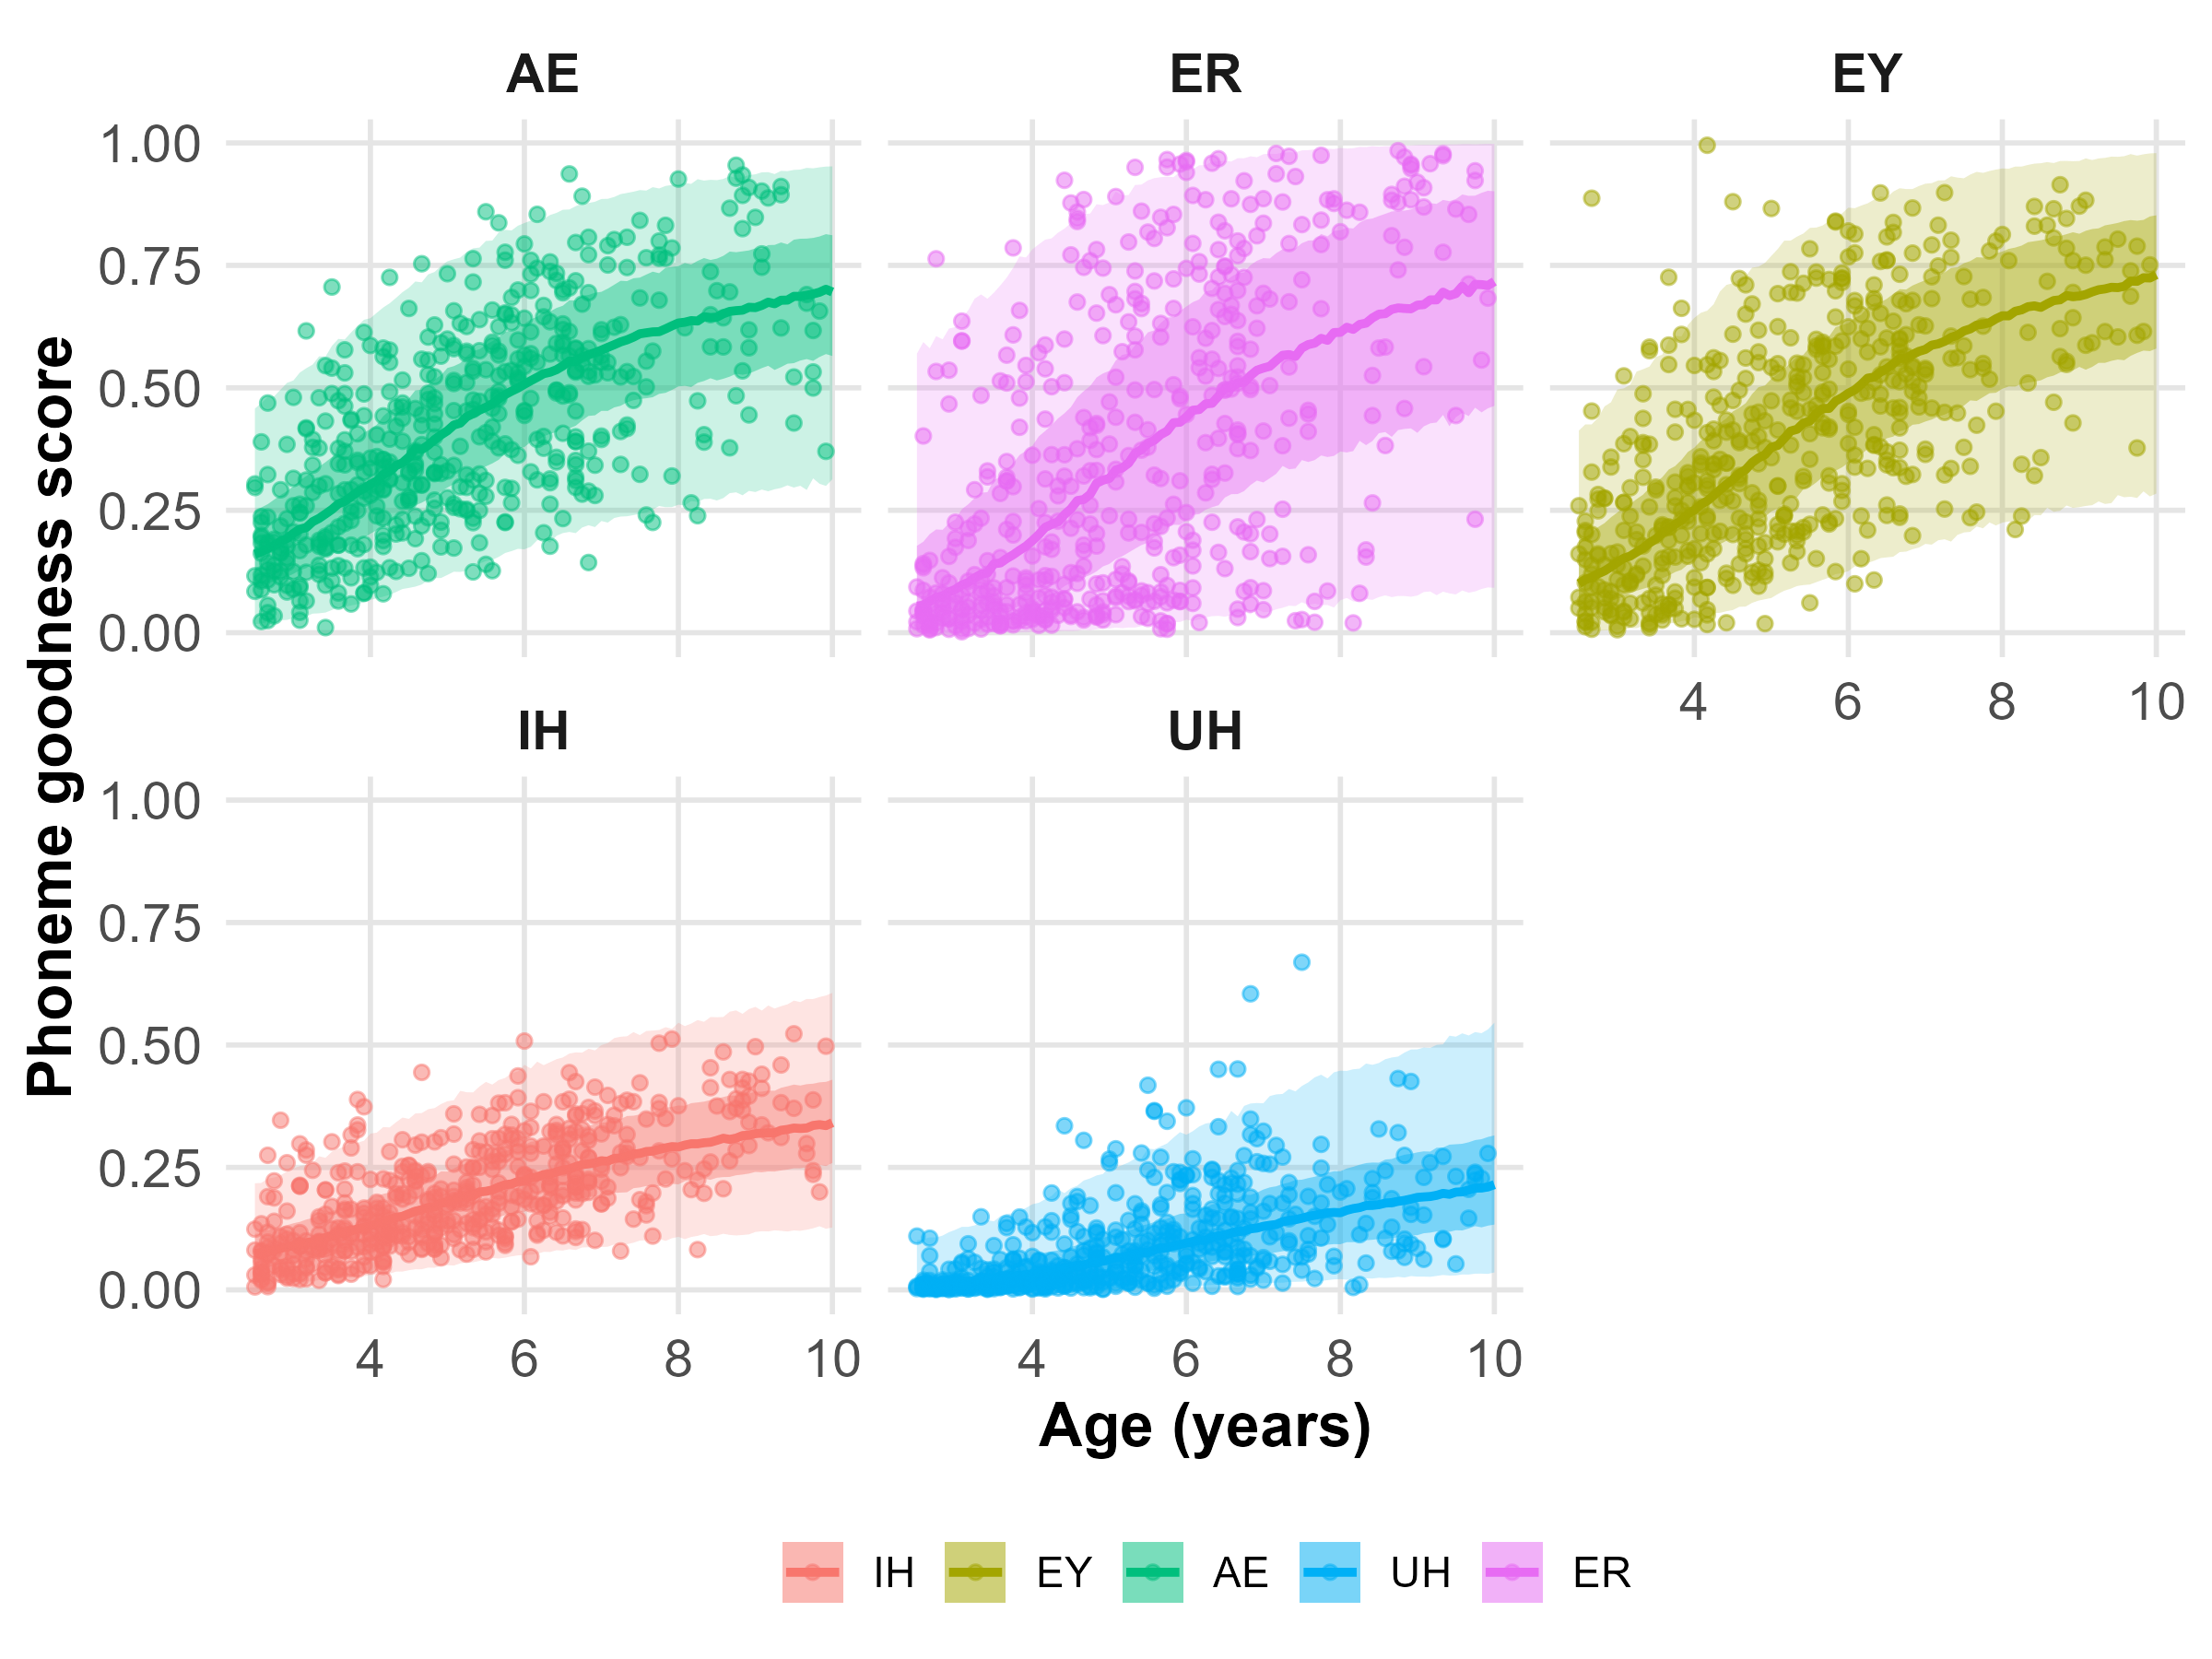
Vowels Level 4 and 5
Model 0
Model 9

Slide 13
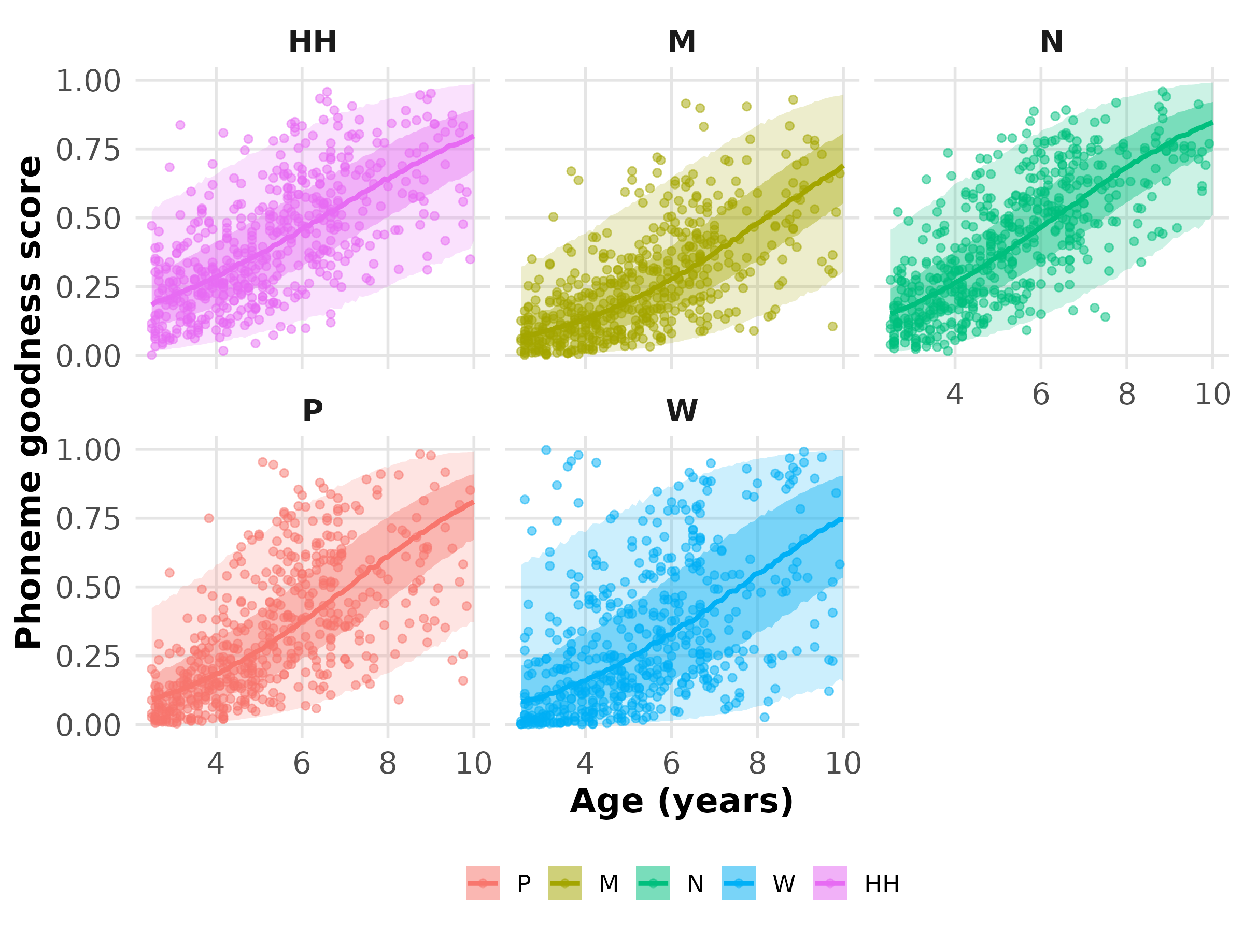

Consonants Level 3
Model 0
Model 9

Slide 14
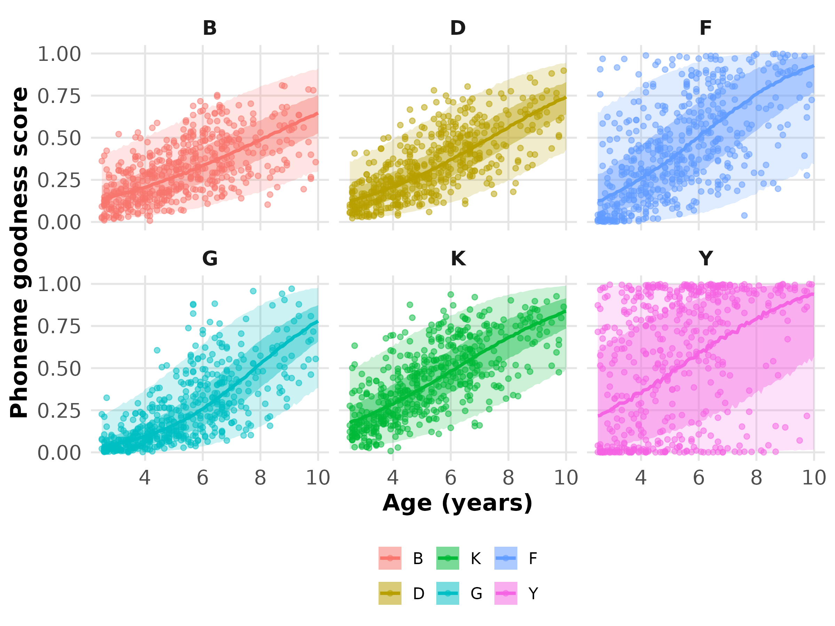
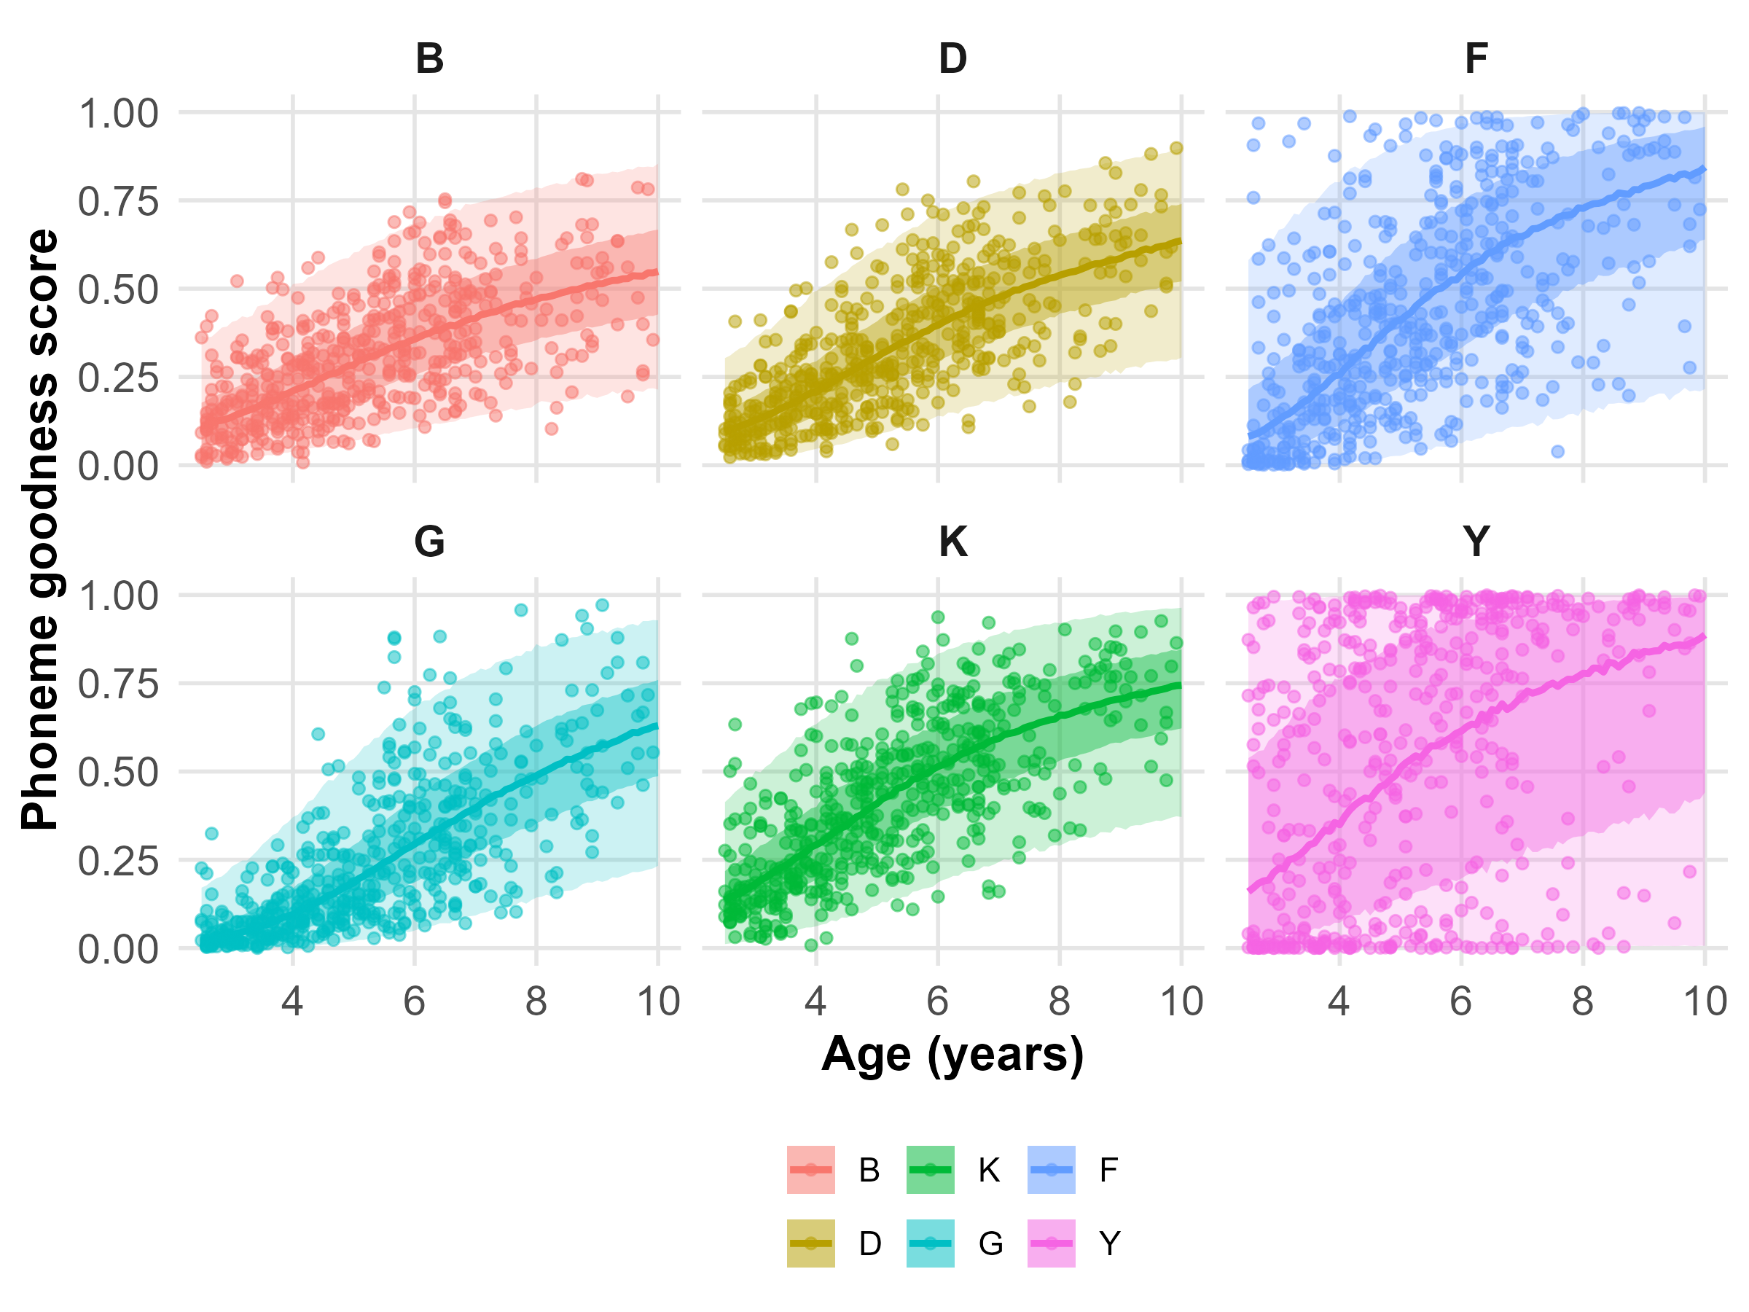
Consonants Level 4
Model 0
Model 9

Slide 15
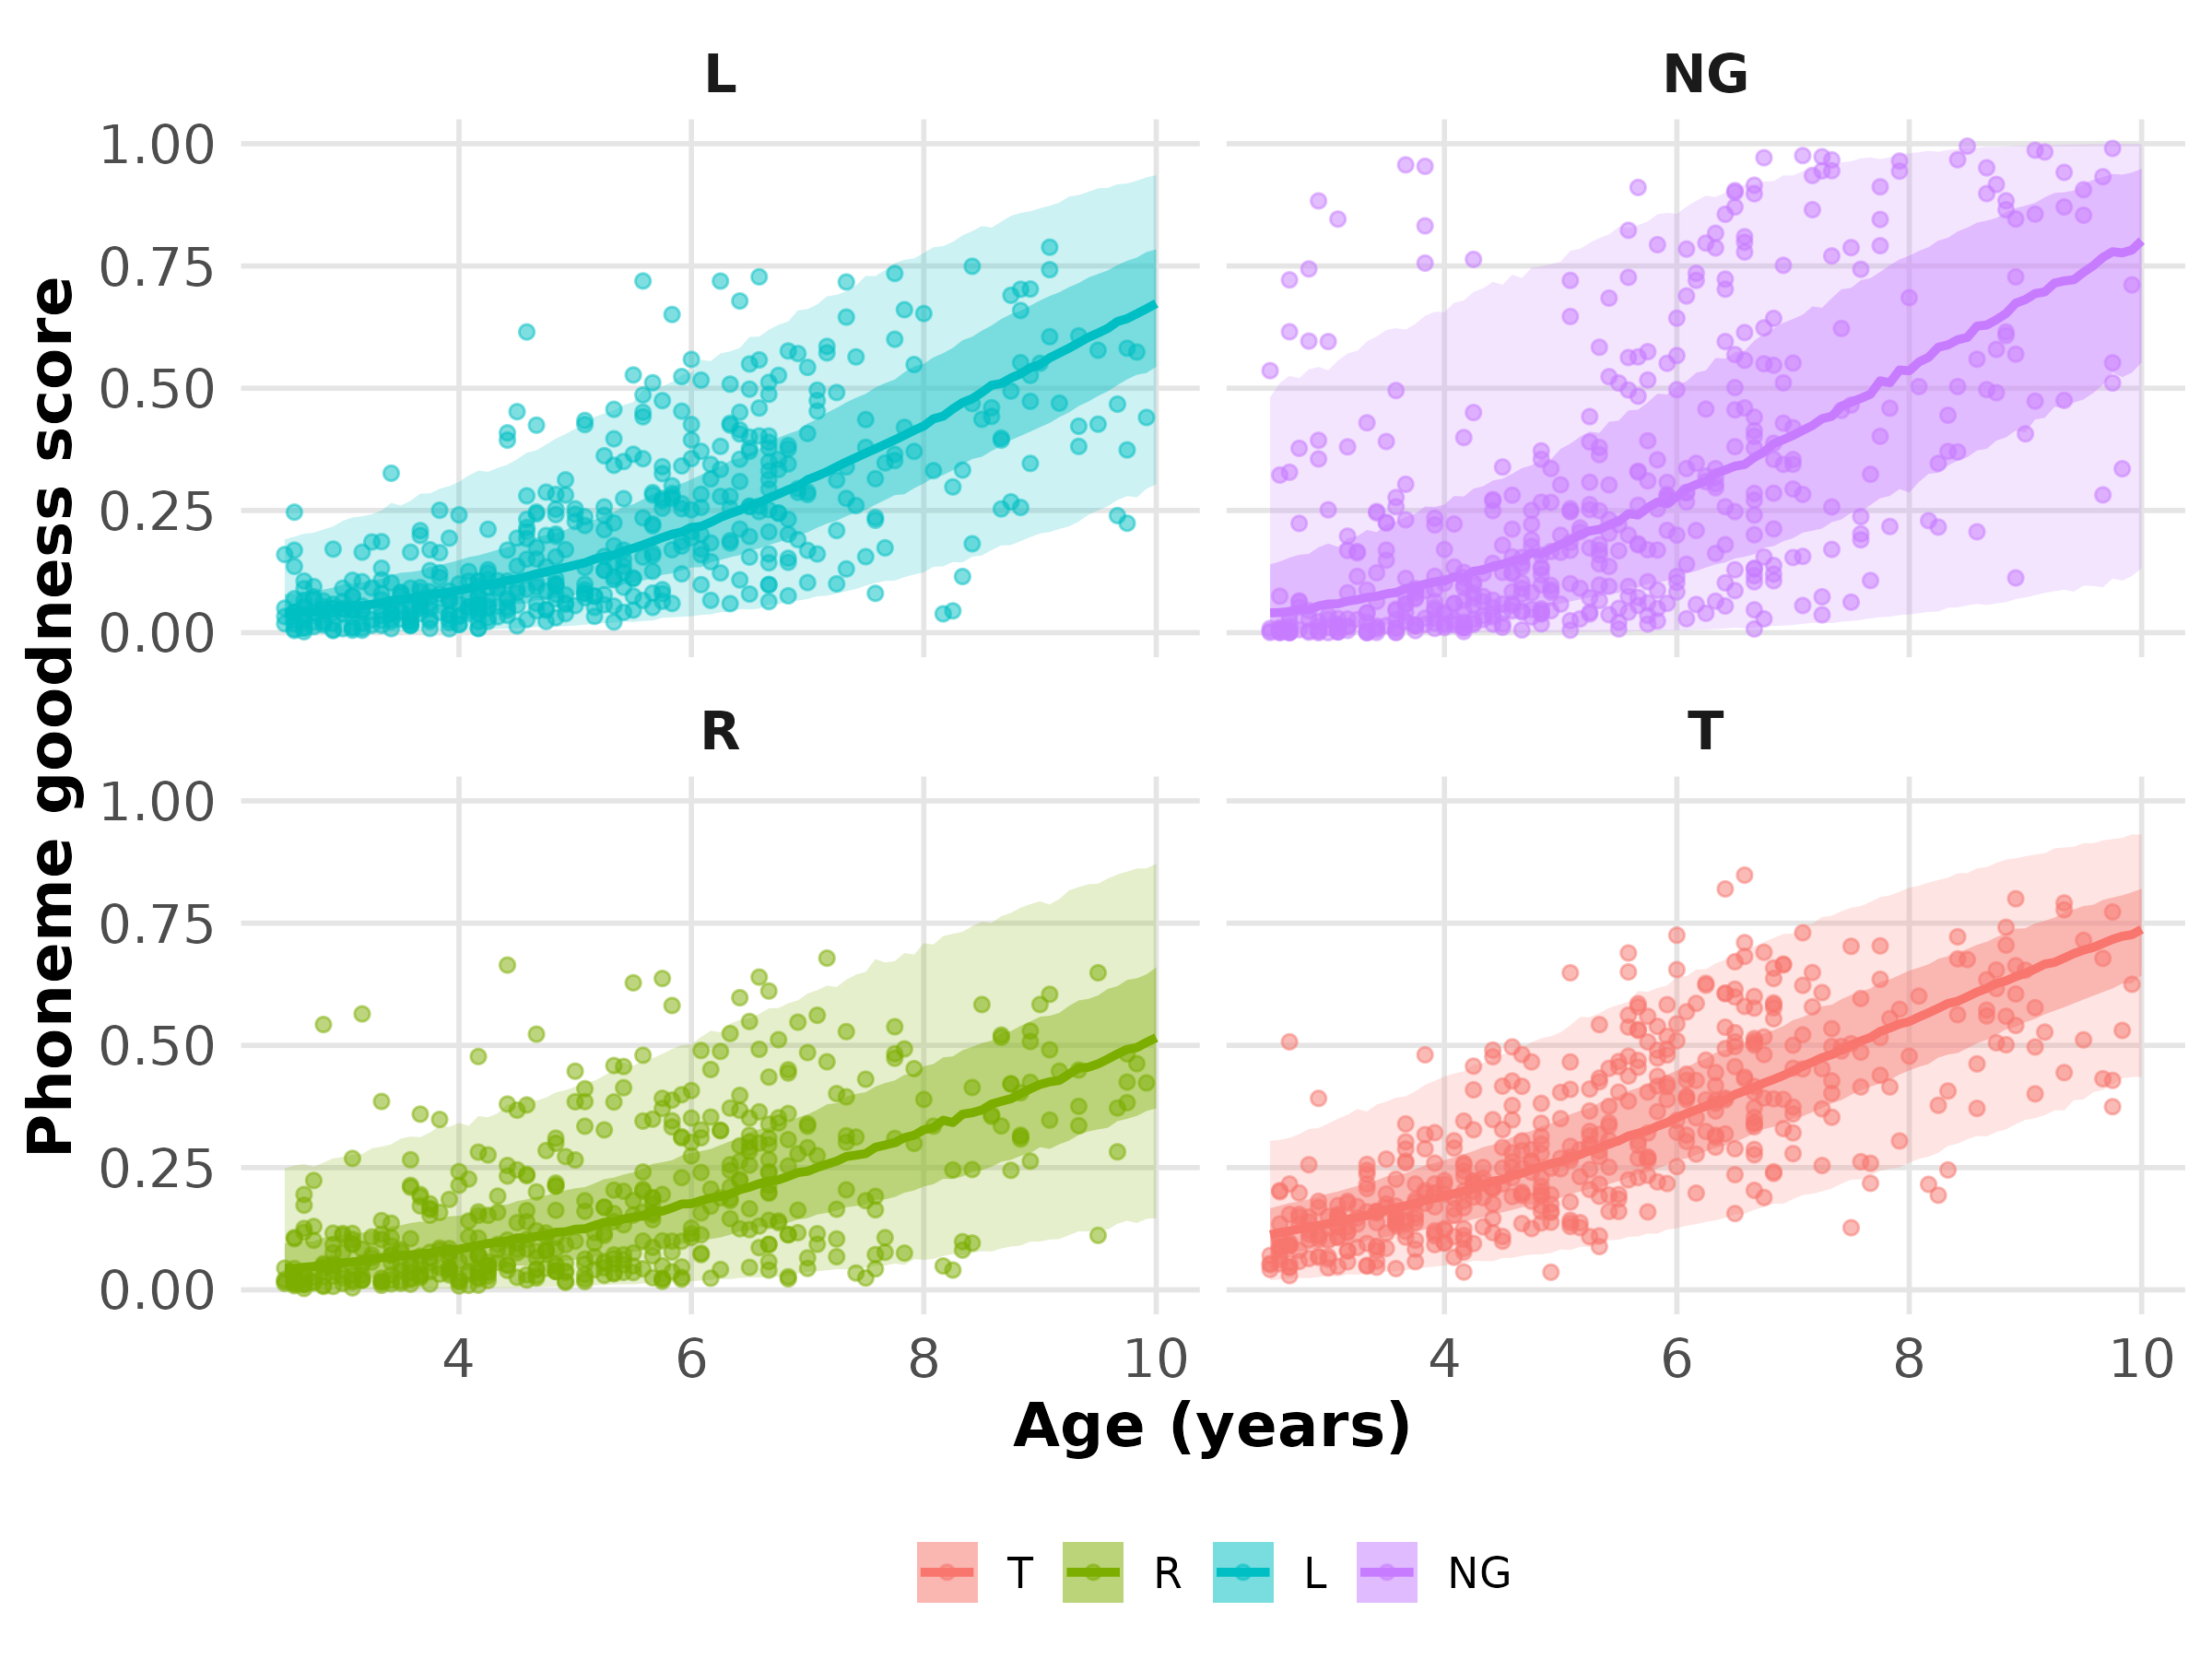
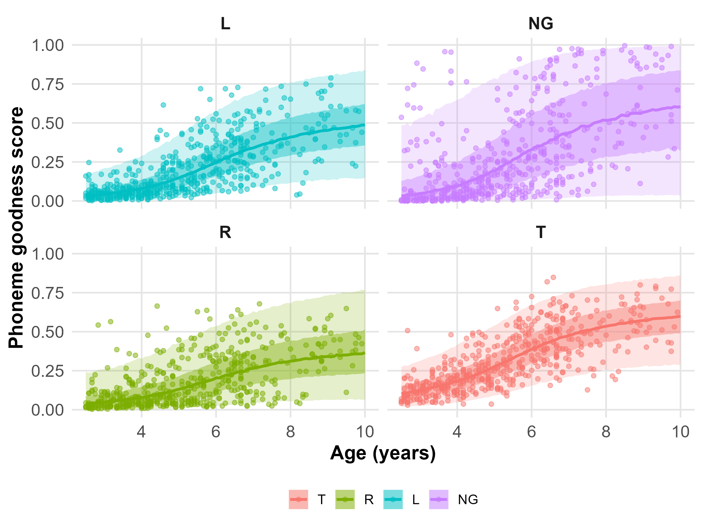
Consonants Level 5
Model 0
Model 9

Slide 16
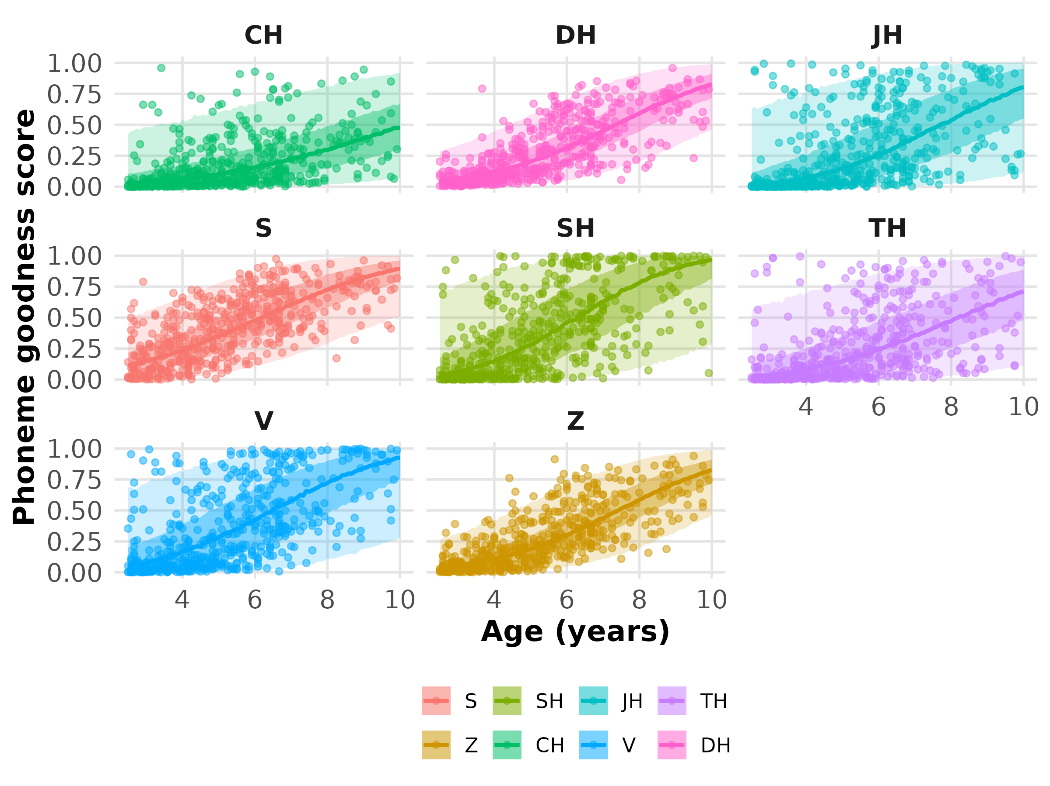
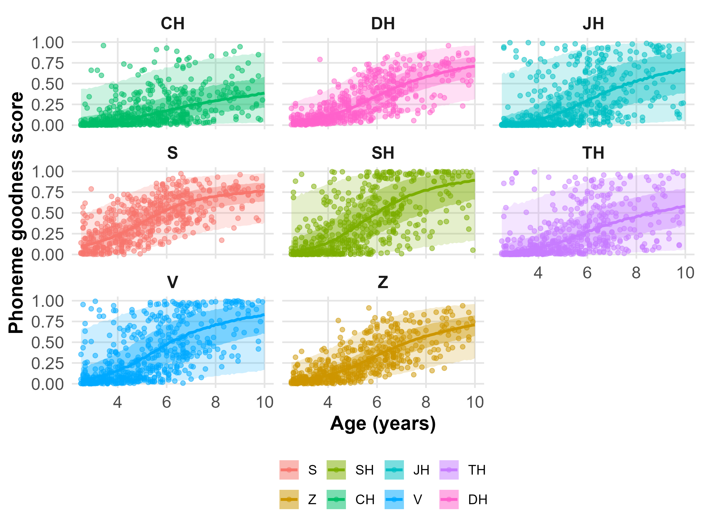
Consonants Level 6
Model 0
Model 9

Slide 17
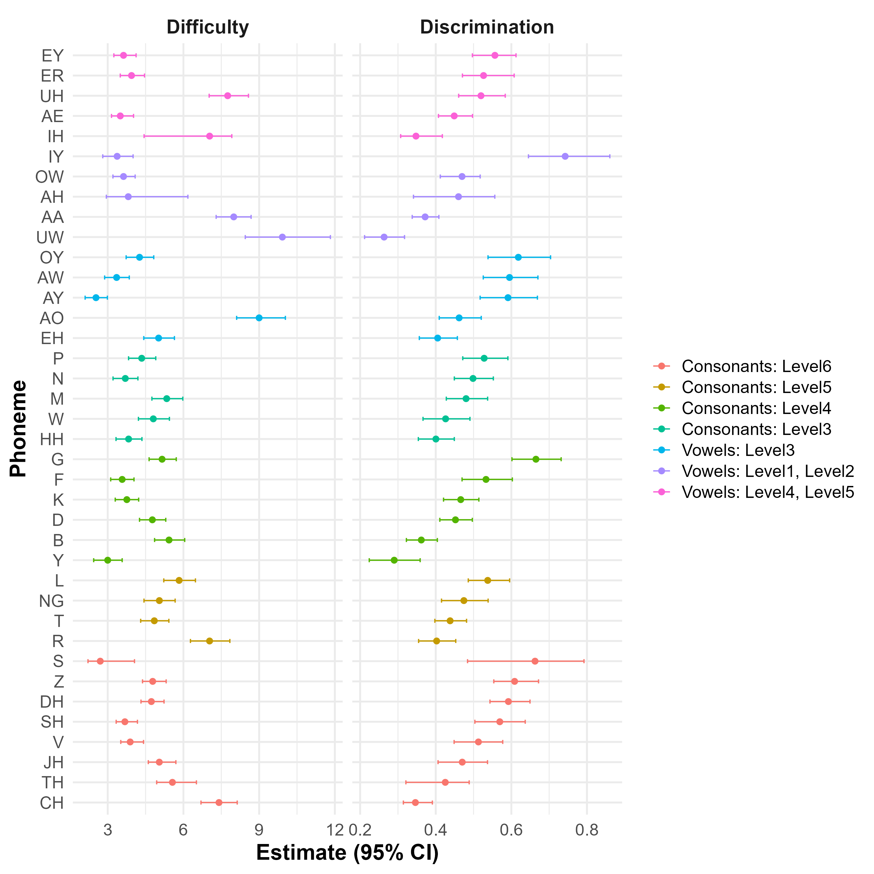
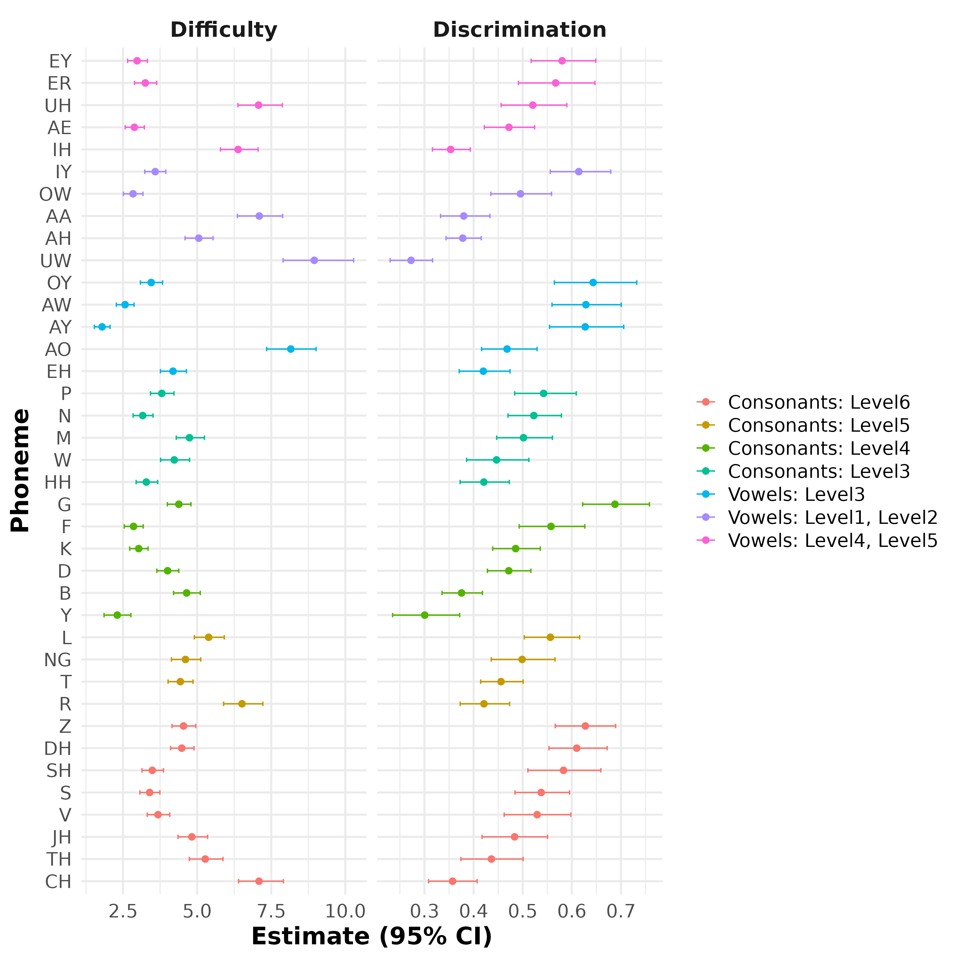
Credible intervals
Model 0
Model 9

Slide 18
Credible intervals (model 9)

Slide 19
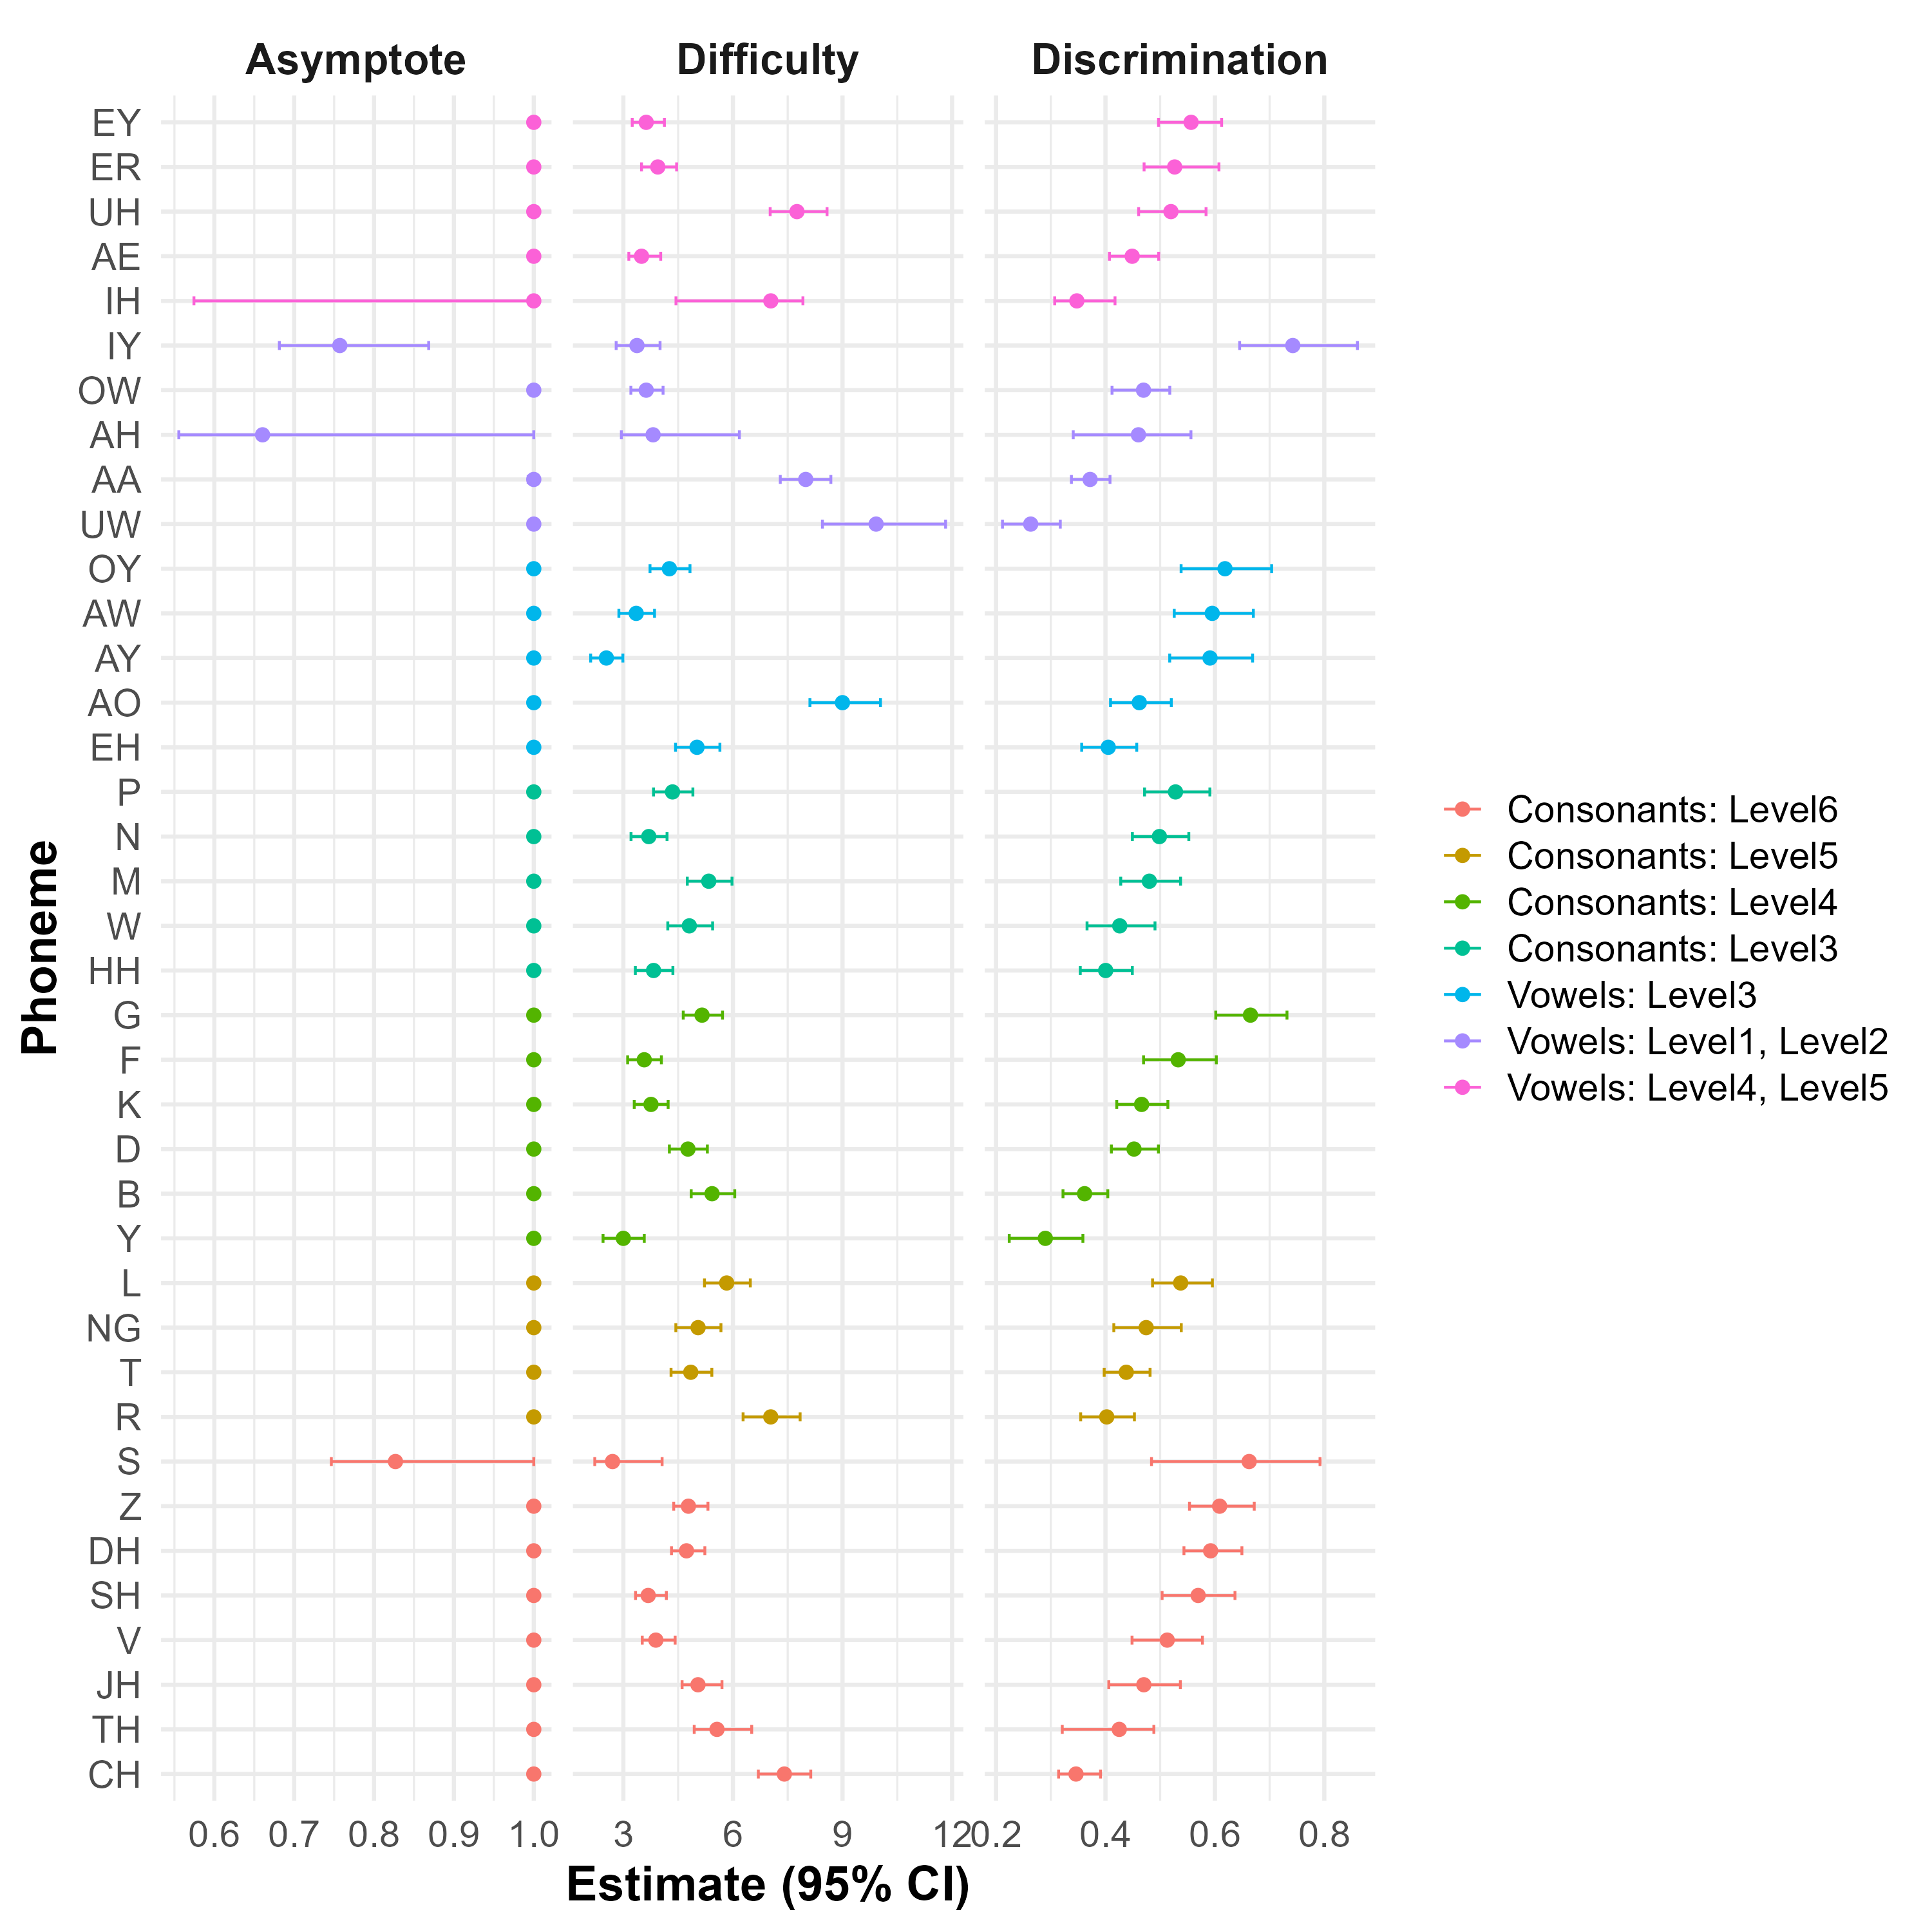
Credible intervals (model 9)

